Slide 1
IPL Winner Prediction
Using Machine Learning
DHARANI P
06 Oct 2025
DA/DS, Offline Batch 2025

Slide 2
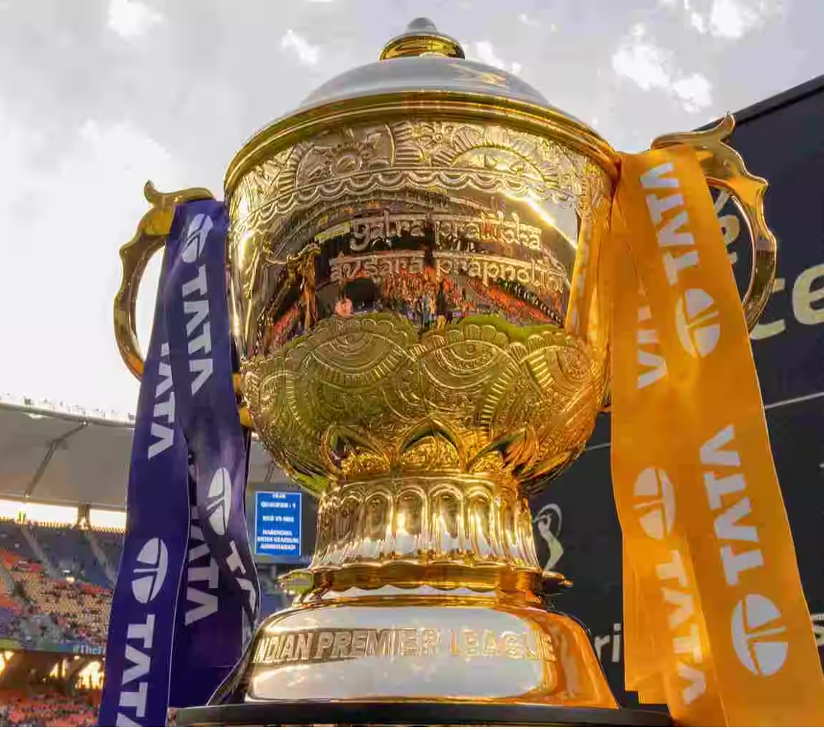
Introduction:
This project predicts match outcomes using machine learning.
Focused on cricket matches (can be adapted to other sports).
Uses historical match data and key features such as:
Season, venue, teams, toss winner/decision
Match result, DL applied, runs, wickets
Multiple ML models are trained and compared to find the best predictor.
Final model can predict winners interactively using user input.

Slide 3

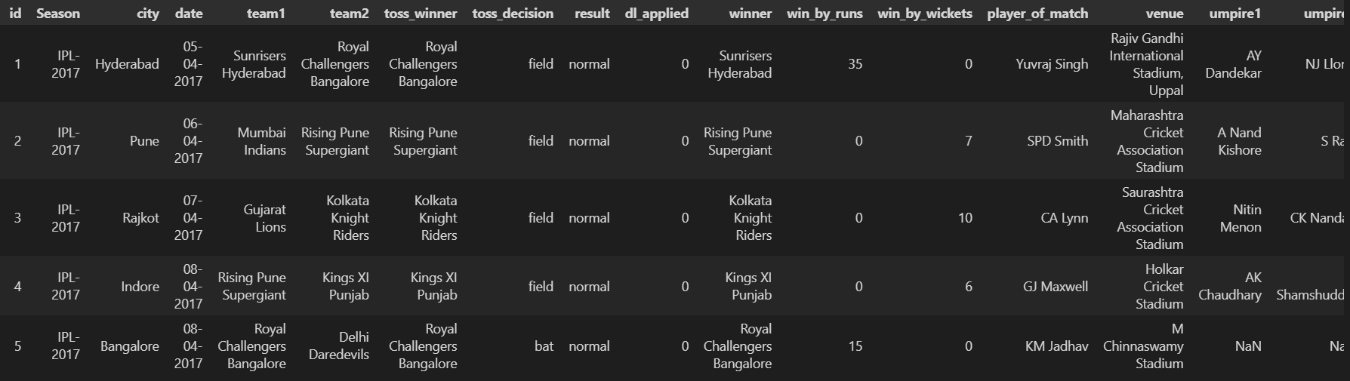
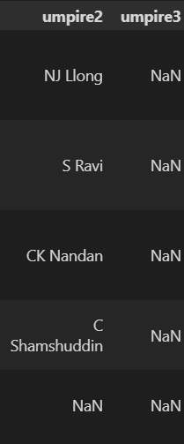
Data Understanding
Dataset size
14 teams data between the years of 2008 to 2019
750+ Rows
Features
Dataset has date, venue, winner, player of the match, etc.,
18 Columns

Slide 4
Data Cleaning
RECAP
1
Checking for Missing Values
A heatmap was also used to visualize missing values and understand their distribution across columns.
This helped us pinpoint which columns required attention.
2
Handling Missing Values
Missing values were handled using the most appropriate methods:
• The columns 'winner' and 'cityish' had missing values.
These were filled with their mode (most frequent value) since they are categorical features
3
Cleaning the 'City' Column
The 'city' column contained inconsistent and missing data.
Steps taken:
• Converted all entries to strings and removed extra spaces
This ensured that every venue had an associated cityish ensured that every venue had an associated city
Outlier Detection and Handling
Outliers in numerical columns like ‘wineberries’ and ‘wineberries’ were identified using the Interquartile Range (IQR) method
4

Slide 5
Exploratory Data Analysis (EDA)
Univariate Analysis - 5
Bivariate Analysis - 4
Multivariate Analysis - 3
1
Number of Matches per Season
4
Top 10 Players With Most Player Of The Match Awards
1
3
Toss Winner vs Match Winner
Toss Winner vs Toss Decision
Go to Slide
Go to Slide
Go to Slide
Go to Slide
2
Toss Decisions
5
Top Toss Winning Teams by Season
2
Toss Winner vs Match Winner
4
Distribution of Win by Runs per Season
Go to Slide
Go to Slide
Go to Slide
Go to Slide
3
Top cities hosting matches
Go to Slide
1
Toss Decision & Match Result by Toss Winner
2
Top Venues Across Seasons
3
Team Wins Across Seasons
Go to Slide
Go to Slide
Go to Slide

Slide 6
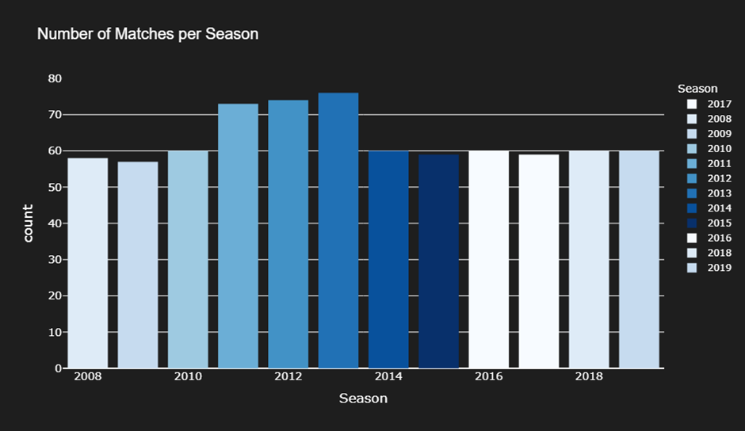
Univariate Analysis
1
Number of Matches per Season
o Key Analyses the number of matches varied across seasons, reflecting changes in format and the number of participating teams.
o IPL 2013 recorded the highest number of matches (76), due to the inclusion of more teams and an extended format.
o Overall, the trend highlights the steady popularity and expansion of the IPL over time, despite minor dips in certain seasons.
Go to EDA

Slide 7
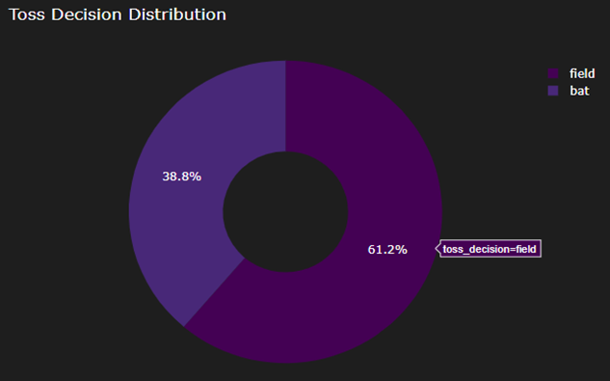
Univariate Analysis
2
Toss Decisions
o Analysis of toss decision reveals the frequency of choosing to bat vs. field after winning the toss.
o Insights: Majority of teams prefer to field first, aligning with modern T20 strategies.
Go to EDA

Slide 8
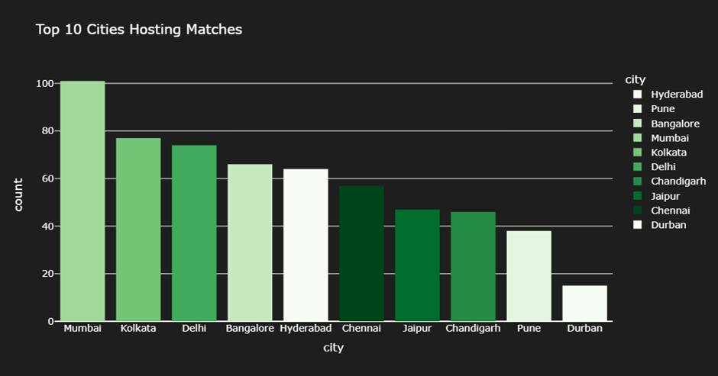
Univariate Analysis
3
Top cities hosting matches
o Mumbai dominates – It has hosted the highest number of matches (well above 100), making it the most popular venue.
o Kolkata and Delhi follow – Both cities are close competitors, with around 75 matches each, forming the second tier.
o Balanced mid-tier – Bangalore, Hyderabad, and Chennai show moderate hosting frequency (60–65 matches), indicating strong but secondary venues.
o Low hosting in some cities – Cities like Pune and Durban hosted the least, with Durban having a very minimal count
Go to EDA

Slide 9
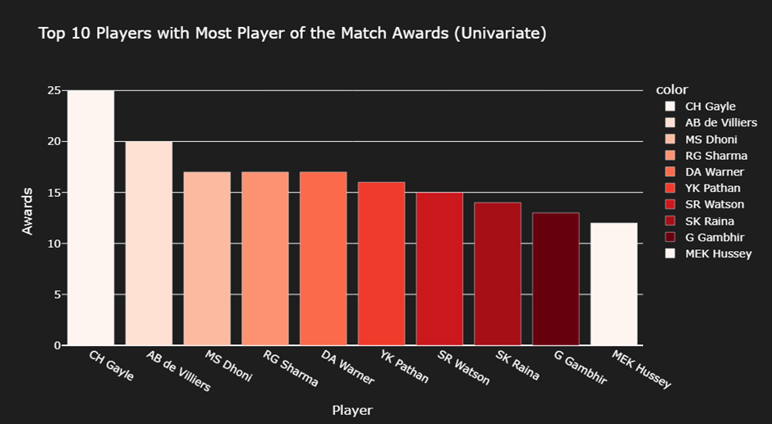
Univariate Analysis
4
Top 10 Players With Most Player Of The Match Awards
o CH Gayle leads the chart with the highest number of Player of the Match awards (~25), highlighting his dominant performances and match-winning ability in multiple IPL seasons.
o AB de Villiers follows closely, showing consistency and impact as one of the most influential overseas players in the league.
o Indian stars like MS Dhoni, Rohit Sharma, and Suresh Raina appear in the top 10, proving their long-term contributions and crucial match-winning performances.
o The distribution shows a competitive mix of both Indian and international players, indicating that impactful performances come from diverse teams and roles (batsmen, all-rounders, etc.).
Go to EDA

Slide 10
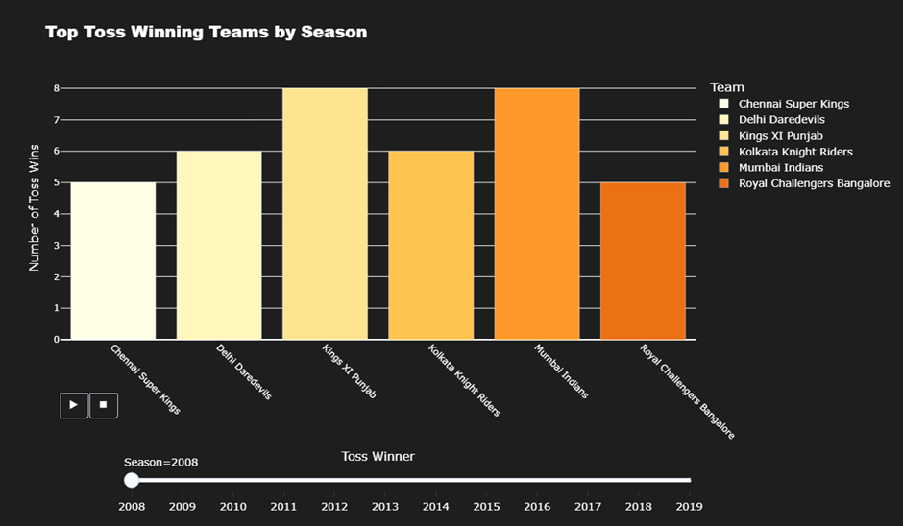
Univariate Analysis
5
Top Toss Winning Teams by Season
o Kings XI Punjab and Mumbai Indians stand out — both have the highest number of toss wins (8) in their respective seasons.
o Chennai Super Kings, Delhi Daredevils, and Kolkata Knight Riders each had a moderate number of toss wins (5–6), showing competitive consistency.
o Royal Challengers Bangalore had fewer toss wins (around 5), suggesting less dominance in toss outcomes compared to other top teams.
o Across seasons, no single team consistently dominated toss wins, indicating that toss success varied significantly year by year.
Go to EDA

Slide 11
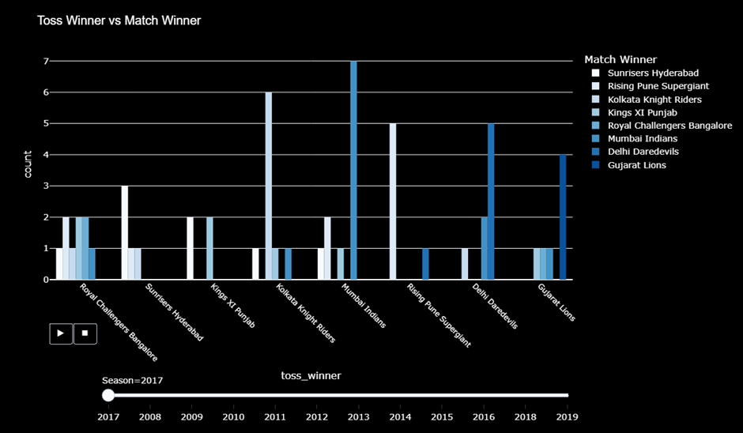
Bivariate Analysis
1
Toss Winner vs Match Winner
o Mumbai Indians clearly stand out — they not only won the most tosses but also frequently converted those into match wins, suggesting strong strategic use of toss advantage.
o Rising Pune Supergiant also shows a strong pattern, converting several toss wins into match wins, indicating effective decision-making after the toss.
o Other teams like Royal Challengers Bangalore, Kings XI Punjab, and Delhi Daredevils show weaker alignment between toss wins and match wins — meaning toss advantage didn’t translate as effectively.
o Overall, winning the toss didn’t guarantee a match win, but teams like Mumbai Indians and Rising Pune Supergiant appear to have leveraged it better than others
Go to EDA

Slide 12
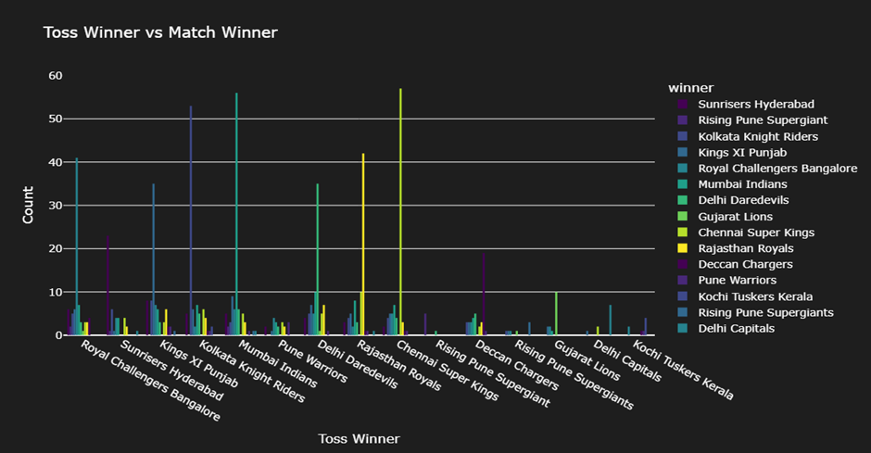
Bivariate Analysis
2
Toss Winner vs Match Winner
o Chennai Super Kings and Mumbai Indians show the strongest alignment between toss wins and match wins — both teams consistently convert toss victories into match success.
o Royal Challengers Bangalore and Delhi Daredevils/Capitals win tosses fairly often but don’t convert them into as many match wins, suggesting weaker post-toss strategies.
o Teams like Rising Pune Supergiant and Rajasthan Royals show occasional high spikes, indicating they had specific strong seasons but lacked long-term consistency.
o Overall, the chart shows that toss advantage is not uniform across teams — strategic execution after winning the toss (like batting/bowling choices) likely plays a larger role in success than the toss itself.
Go to EDA

Slide 13
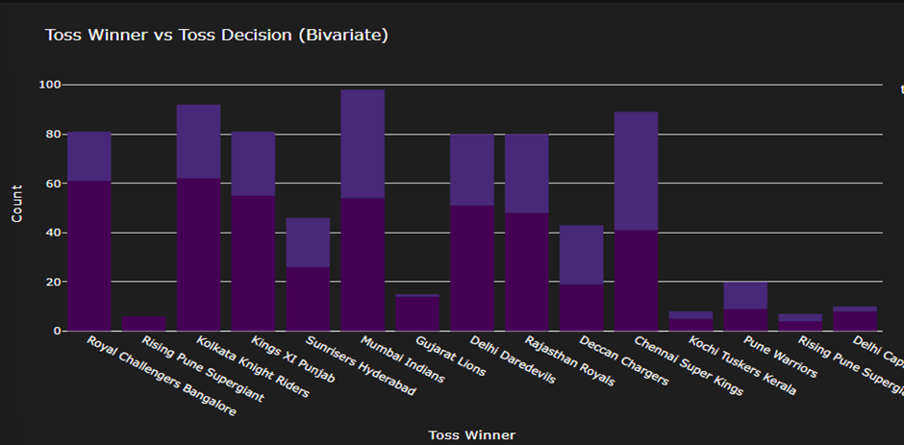
Bivariate Analysis
3
Toss Winner vs Toss Decision
o The split bars (two colors per team) suggest that both batting and fielding decisions are commonly chosen after winning the toss — though some teams show a strong bias toward one.
o Mumbai Indians and Sunrisers Hyderabad seem to have a more balanced decision pattern, indicating flexible strategies depending on conditions.
o Teams like Gujarat Lions, Kochi Tuskers Kerala, and Pune Warriors show very few tosses overall — consistent with their short participation span in the IPL
Go to EDA

Slide 14
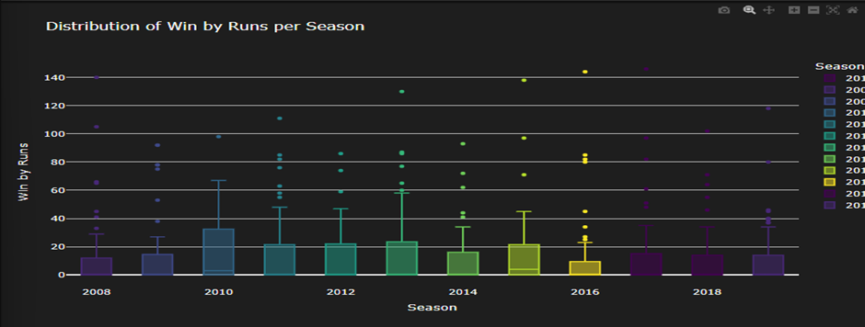
Bivariate Analysis
4
Distribution of Win by Runs per Season
Most matches are won by small margins — the median win by runs each season is generally below 30, showing how competitive most IPL games are.
2010 and 2016 stand out with a wider spread and higher outliers, suggesting several dominant victories by large margins (some wins over 120 runs).
The interquartile range (box height) remains fairly consistent, indicating that the general pattern of run margins hasn’t changed drastically over the years.
Outliers appear every season, meaning that at least a few matches each year result in unusually large wins — often due to exceptional team or batting performances
Go to EDA

Slide 15
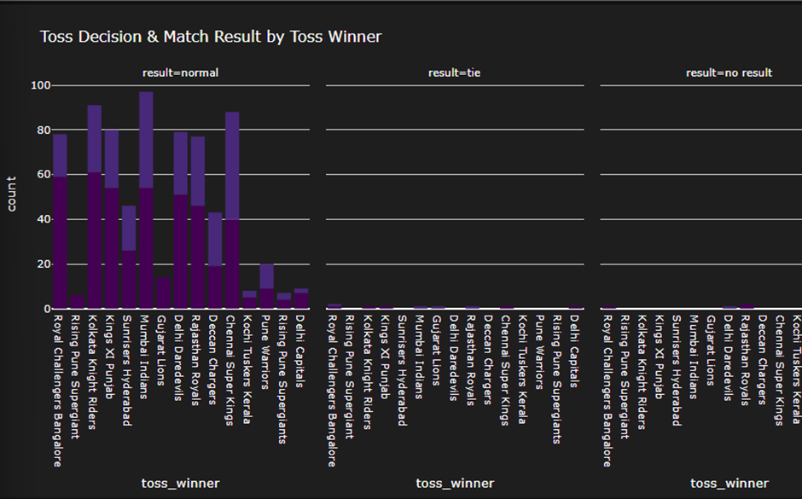
Multivariate Analysis
1
Toss Decision & Match Result by Toss Winner
o Most matches ended with normal results, while ties and no-results were extremely rare, showing consistent match completions across seasons.
o Mumbai Indians, Kolkata Knight Riders, and Chennai Super Kings stand out as frequent toss winners and participants in normal-result matches — indicating consistent performance and presence in the league.
o Teams like Kochi Tuskers Kerala and Pune Warriors appear less frequently, reflecting their short-lived participation in the IPL.
o The similarity in bar heights for several top teams implies that winning the toss doesn’t drastically influence the match outcome — success likely depends more on team performance than the toss itself.
Go to EDA

Slide 16
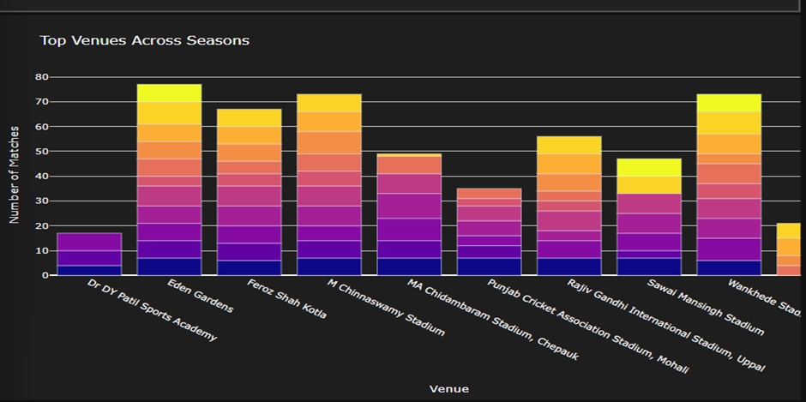
Multivariate Analysis
2
Top Venues Across Seasons
o Eden Gardens hosted the highest number of matches across seasons, marking it as one of the IPL’s most frequently used and iconic venues.
o M. Chinna swamy Stadium and Wankhede Stadium follow closely, reflecting their central roles in hosting major IPL games, especially for Royal Challengers Bangalore and Mumbai Indians.
o Dr. DY Patil Sports Academy and Sawai Mansingh Stadium hosted relatively fewer matches, possibly due to venue rotation or renovation periods.
o The diverse color stacking shows that all major venues have hosted matches consistently across multiple seasons — indicating the IPL’s wide geographic reach and balanced venue distribution
Go to EDA

Slide 17
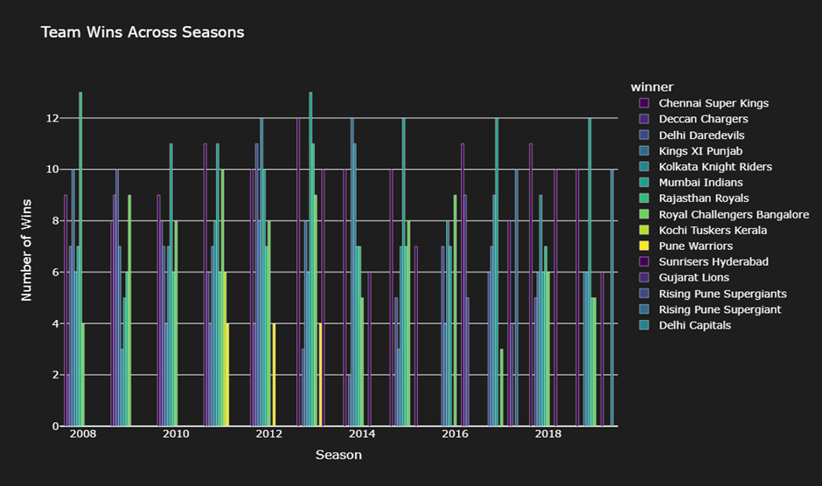
Multivariate Analysis
3
Team Wins Across Seasons
o Mumbai Indians and Chennai Super Kings consistently show up with high win counts (often 10–12 per season), confirming their dominance and consistency across IPL history.
o Kolkata Knight Riders and Sunrisers Hyderabad also maintain steady performance, regularly winning 7–10 matches in most seasons.
o Short-lived teams like Kochi Tuskers Kerala, Pune Warriors, and Gujarat Lions show limited appearances and lower win counts, reflecting their brief IPL tenures.
o No team dominates every season — the spread of colors each year shows how competition has remained balanced, with multiple teams performing strongly in different seasons.
Go to EDA

Slide 18
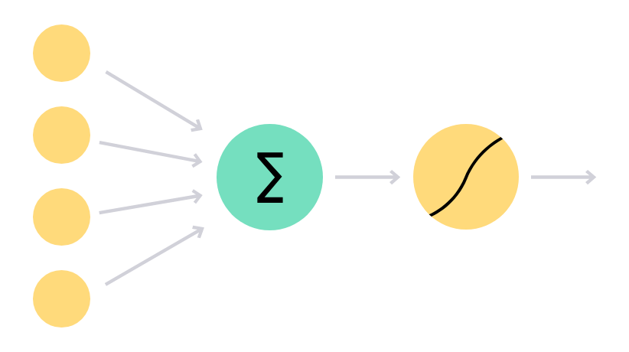
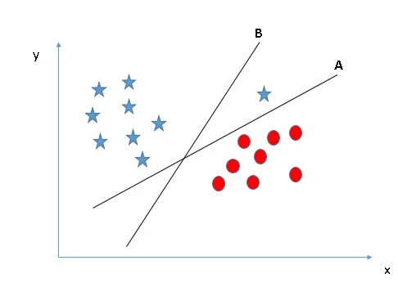

Modeling Process
Logistic Regression
Support Vector Machine (SVM)
Data Processing
Removed unnecessary columns like date and umpire info
Label encoding used to convert team names, venues, and decisions into numbers
Split data into 80% training and 20% testing (kept class balance)
StandardScaler used to normalize numerical data
Final data expanded from 15 to 332 features after encoding
Used as a baseline model for simplicity and easy interpretation
Achieved 57.89% accuracy — basic performance level
Predicted frequent winners (Mumbai Indians, CSK, KKR) better than rare teams
Struggled with teams having fewer matches
Served as a starting point for testing complex models
Applied to capture non-linear patterns in the data
Accuracy: 60.52%, slightly better than Logistic Regression
Better results for popular teams (MI, CSK, KKR), weak for rare teams
Misclassifications occurred for underrepresented teams
Improved pattern recognition but limited by class imbalance

Slide 19


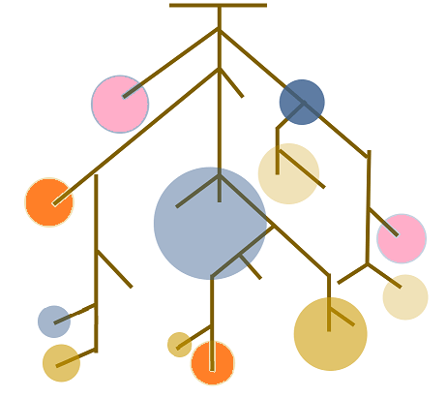
Modeling Process
K-Nearest Neighbors (KNN)
Decision Tree Classifier
Random Forest Classifier
Works by comparing matches to their nearest neighbors
Accuracy: 63.15%, higher than Logistic Regression and SVM
Good for strong teams; weak for rare teams
Sensitive to k value and affected by high-dimensional data
Captured local patterns but not very scalable
Uses decision rules to predict winners
Accuracy: 81.98%, strong improvement over previous models
Excellent for dominant teams; weaker for rare teams
Some overfitting risk — may memorize training data
Shows the importance of non-linear feature relationships
Ensemble model combining many Decision Trees
Accuracy: 81.98%, but more stable than a single tree
High precision and recall for strong teams
Reduced overfitting and improved reliability
Balanced and robust model for prediction

Slide 20
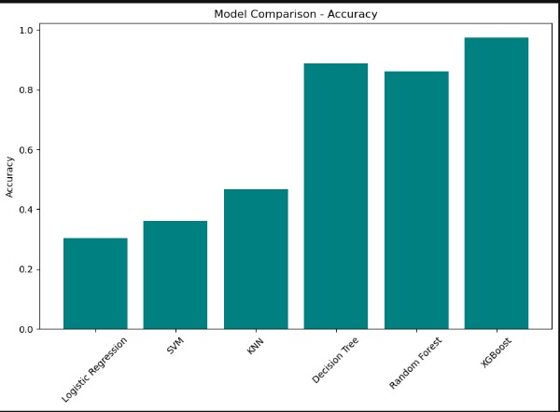
Best Model Selection
Final Model Selected: Boost for its robustness and consistency.
Selection details as follows
Model Accuracy Comparison
Boost – Detailed Metrics
Key Insights
Model Accuracy
Logistic Regression 0.3026 Poor performance, not suitable
SVM 0.3627 Slight improvement but still weak
KNN 0.4703 Moderate, lacks consistency
Decision Tree 0.8903 Strong performance
Random Forest 0.8629 Good but slightly lower than DT
Boost 0.9705 Best performer — highly robust
Conclusion
Basic models (Logistic Regression, SVM, KNN) showed low performance
(< 0.50).
Tree-based models (Decision Tree, Random Forest) achieved strong accuracy (~93%).
Boost outperformed all others (95% accuracy) with balanced metrics.
Accuracy: 0.950
Precision: 0.94
Recall: 0.94
F1 Score: 0.94

Slide 21

Final Insights – IPL Match Prediction Project
+95% accuracy
1. Data Preparation & Analysis
Cleaned and encoded IPL match data (season, city, teams, toss, venue, results).
Explored key trends — top cities: Mumbai, Kolkata, Delhi; toss and venue heavily influenced outcomes.
2. Model Development & Evaluation
Tested six models: Lorge, SVM, KNN, Decision Tree, Random Forest, Boost.
Boost achieved 97% accuracy, outperforming all others across Precision, Recall, and F1 Score.
3. Best Model & Prediction System
Boost chosen for final deployment due to robustness and consistency.
Built an interactive prediction system accepting user inputs to forecast match winners.
Machine learning effectively predicts IPL outcomes using historical data
Boost stands as the most reliable model for real-world prediction and strategic insights.

Slide 22
THANK YOU!

